Slide 1
Random Variables

Slide 2
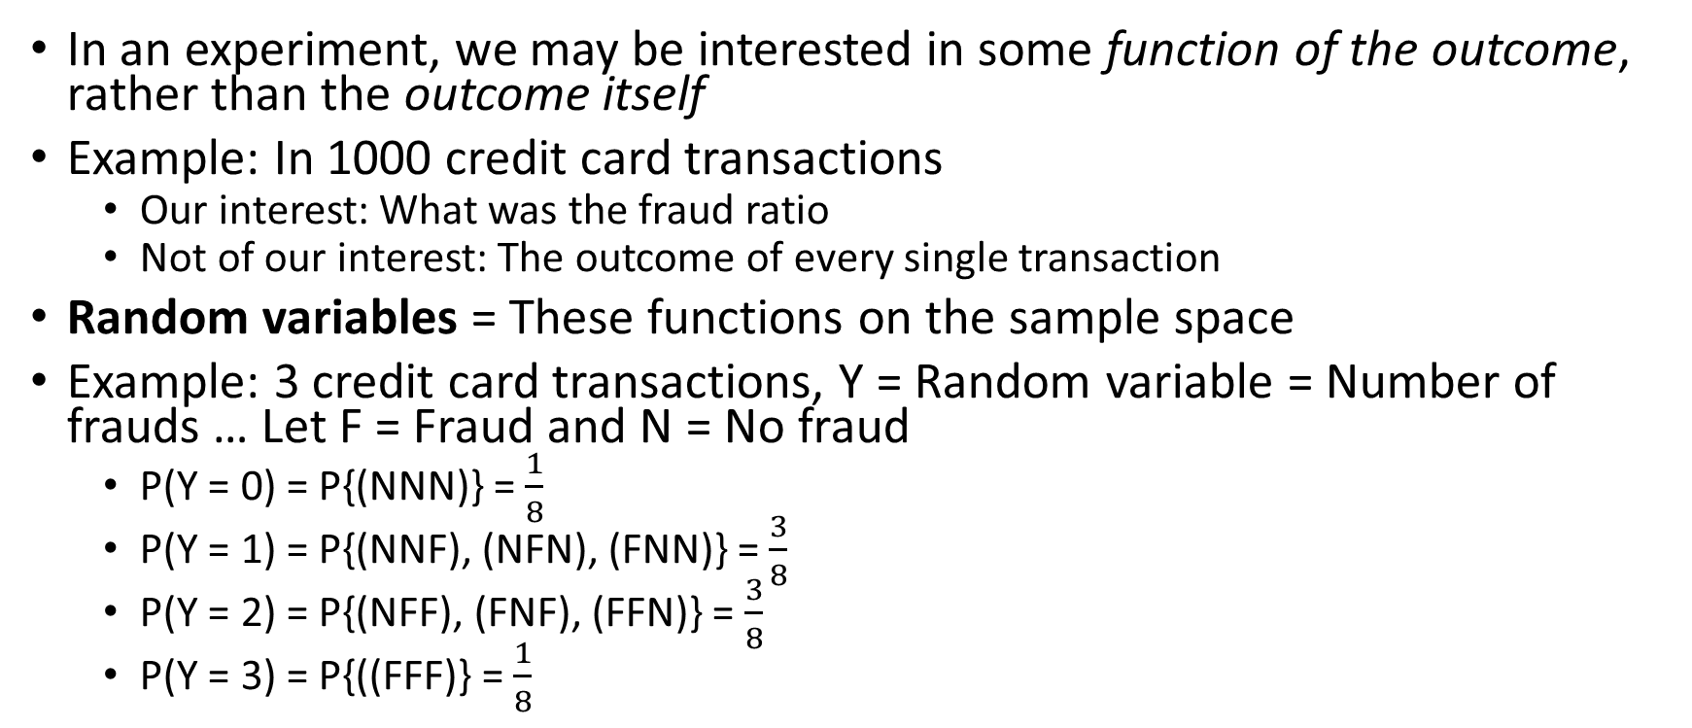
Random Variables
In an experiment, we may be interested in some function of the outcome, rather than the outcome itself
Example: In 1000 credit card transactions
Our interest: What was the fraud ratio
Not of our interest: The outcome of every single transaction
Random variables = These functions on the sample space
Example: 3 credit card transactions, Y = Random variable = Number of frauds … Let F = Fraud and N = No fraud
P(Y = 0) = P{(NNN)} = $\frac{1}{8}$
P(Y = 1) = P{(NNF), (NFN), (FNN)} = $\frac{3}{8}$
P(Y = 2) = P{(NFF), (FNF), (FFN)} = $\frac{3}{8}$
P(Y = 3) = P{((FFF)} = $\frac{1}{8}$

Slide 3
Random Variables: Example
A life insurance agent has two elderly clients with policy value of Rs 1 crore upon death
Event Y = Younger of the two dies, P(Y) = 0.05
Event O = Older of the two dies, P(O) = 0.10
Y and O are independent
X = Random variable representing the amount of money paid out (in crores) based on who dies
Possible values for X: 0, 1, 2 crore
Nobody dies: P(X = 0) = P(Y^{c}O^{c}) = 0.95 x 0.90 = 0.855 or 85.5%
One of them dies: P(X = 1) = P(YO^{c}) + P(Y^{c}O) = (0.05 x 0.90) + (0.95 x 0.10) = 0.140 or 14%
Both die: P(X = 2) = P(YO) = (0.05 x 0.10) = 0.005 or 0.5%

Slide 4
Random Variable Types
Discrete random variable: Can only take on countable number of possible values
Credit ratings: AAA, AA, B, BBB, etc
Number of orders received on a shopping website (0, 1, 2, 3, …)
Customer churn: 0 = no churn, 1 = churn
Continuous random variable: Can take on any value in a certain interval
Market share of a company (Infinite possible values between 0% and 100%, e.g. 45.123%)
Time taken to place an online order (e.g. 2.5 minutes or 2.55 minutes, etc)
Waiting time at an ATM (e.g. 30.2 seconds or 45.76 seconds, etc)

Slide 5
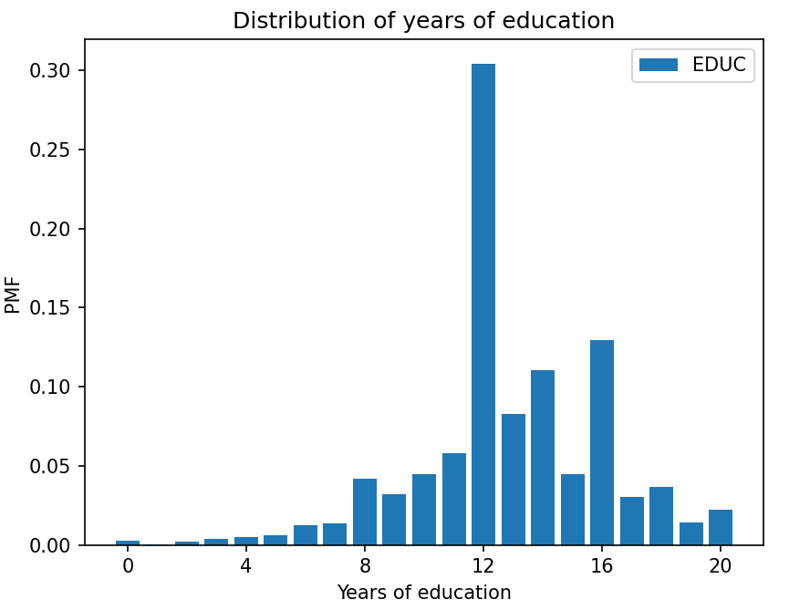
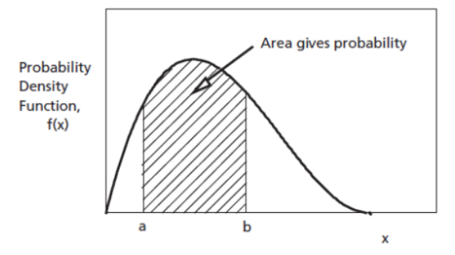
Probability Distribution
Distribution: Describes all the probable outcomes of a variable
Discrete distribution: Sum of all individual probabilities must equal 1
Continuous distribution: Total area under the probability curve (density) equals 1

Slide 6
Probability Distribution Types and Estimations
Probability Distribution Types
Discrete
Continuous
Uniform
Binomial
Poisson
Uniform
Normal
Probability Mass Function (PMF)
Probability Density Function (PDF)
Cumulative Distribution Function (CDF)

Slide 7
Discrete Distributions: (1) Uniform Distribution
Note: Uniform Distribution can also fall under continuous probability distributions category, depending on what we are measuring. If the observations are not discrete, a uniform distribution becomes continuous.
Uniform Discrete Distribution: Throw of a dice (exactly 1, 2, …, 6)
Uniform Continuous Distribution: Time taken by a flight (can go up to nano seconds and beyond)

Slide 8
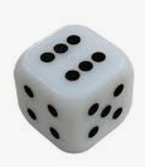
Uniform Distribution
Rolling a fair die: 6 discrete, equally probable outcomes
We can roll a 1 or 2, but not 1.5
The probabilities of each outcome are evenly distributed across the sample space
Code: C:\code\Data Analytics\uniform_dist.py

Slide 9
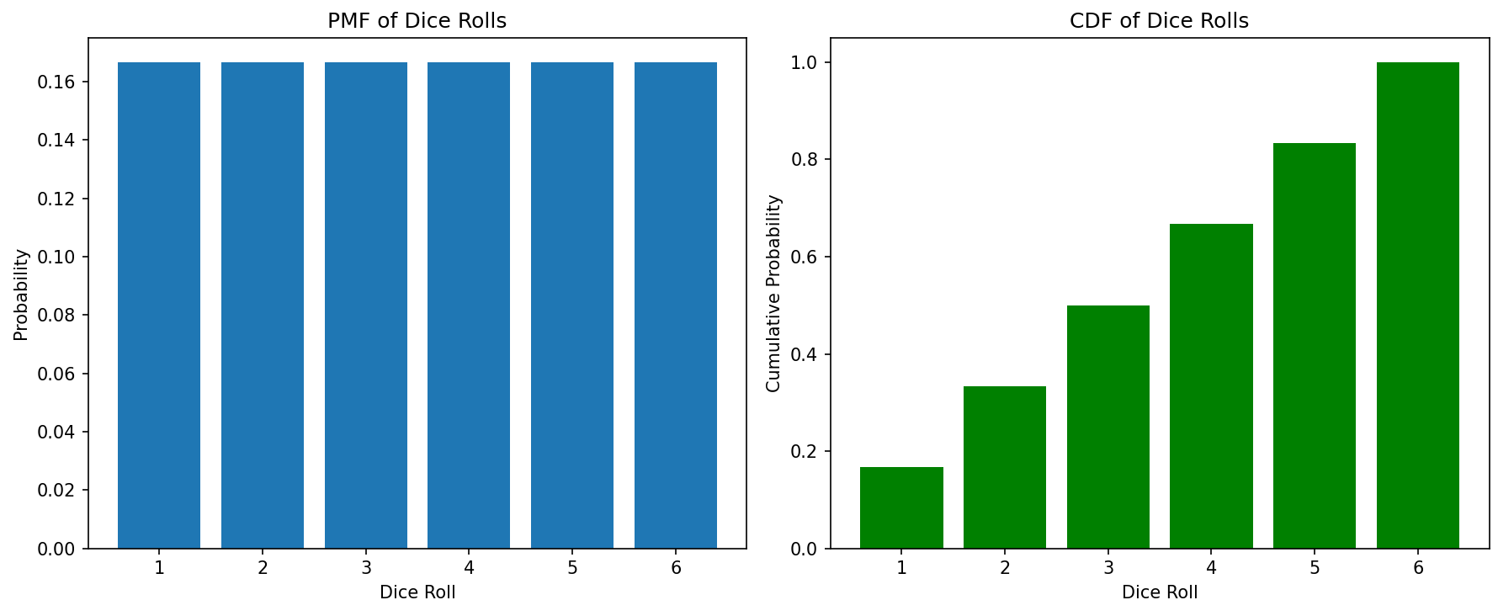
Uniform Distribution
Rolling a die has 6 equal probabilities and their total adds to 1

Slide 10
Discrete Distributions: (2) Binomial Distribution

Slide 11
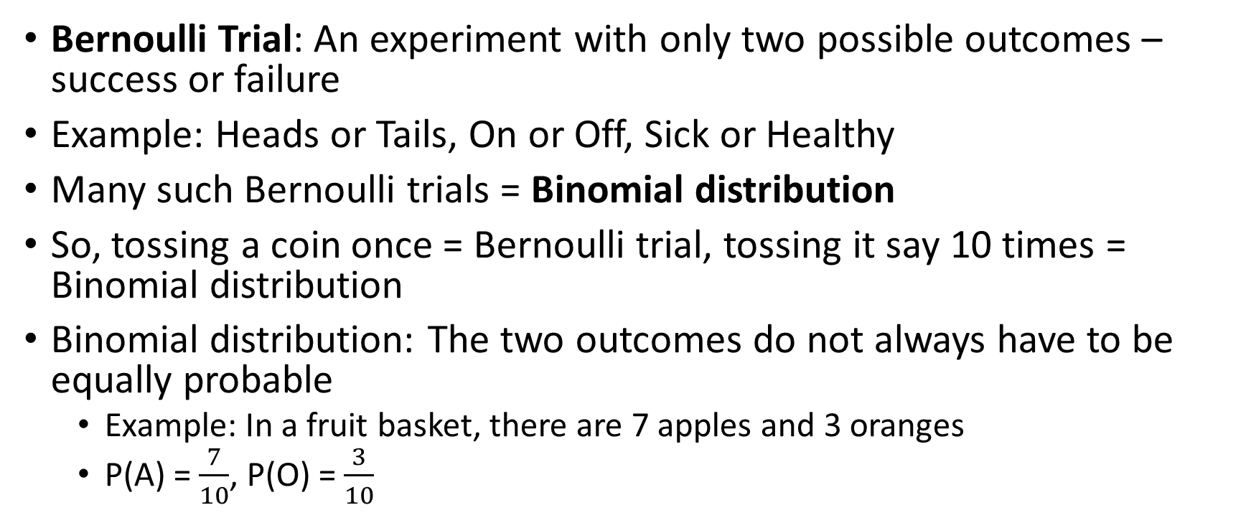
Binomial Distribution
Bernoulli Trial: An experiment with only two possible outcomes – success or failure
Example: Heads or Tails, On or Off, Sick or Healthy
Many such Bernoulli trials = Binomial distribution
So, tossing a coin once = Bernoulli trial, tossing it say 10 times = Binomial distribution
Binomial distribution: The two outcomes do not always have to be equally probable
Example: In a fruit basket, there are 7 apples and 3 oranges
P(A) = $\frac{7}{10}$, P(O) = $\frac{3}{10}$

Slide 12

Binomial Distribution Formula
Problem: Calculate the probability that 3 out of 5 students like Python, when in general 66% students like Python
Number of students liking Python, e.g. 3
Probability that someone likes Python, e.g. 66%
p(x | n, p) = $\left(\frac{n!}{x!\left(n−x\right)!}\right)px \left(1−p\right)n−x$
Probability
Number of students we asked, e.g. 5

Slide 13
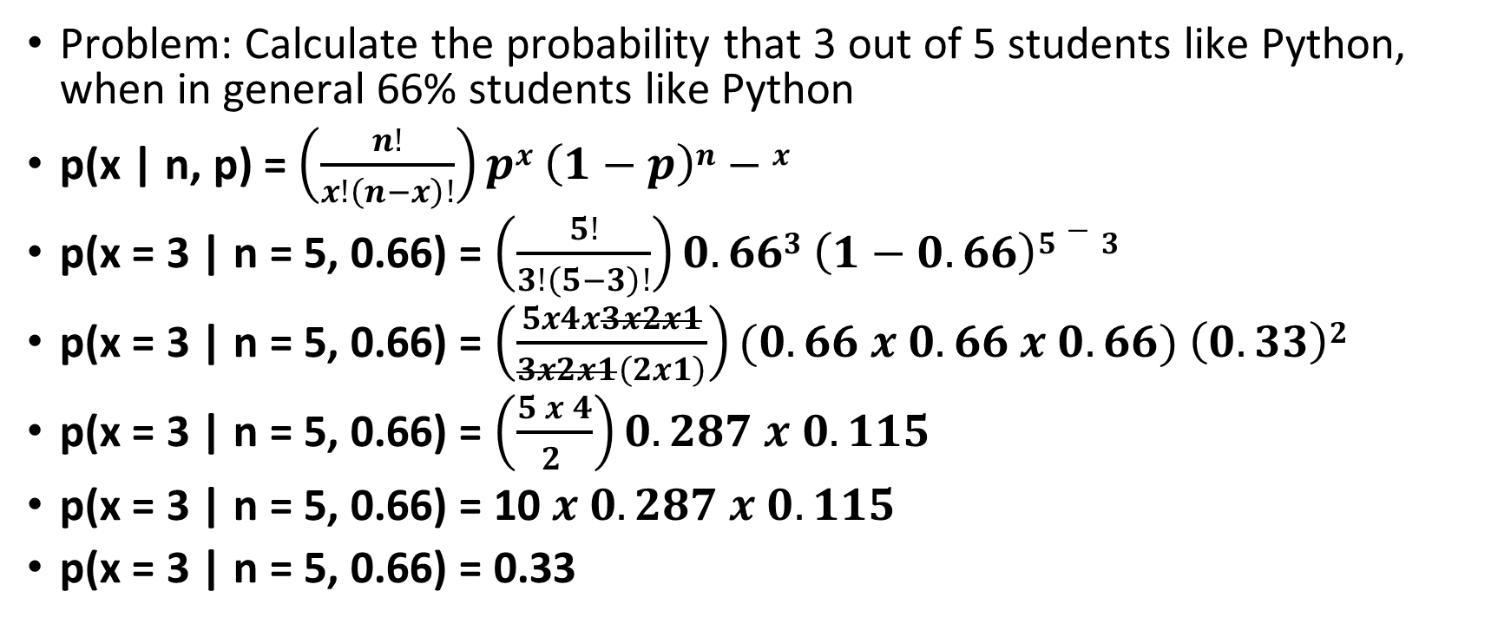
Binomial Distribution Example (C:\code\Data Analytics\binom_student.py)
Problem: Calculate the probability that 3 out of 5 students like Python, when in general 66% students like Python
p(x | n, p) = $\left(\frac{n!}{x!\left(n−x\right)!}\right)px \left(1−p\right)n−x$
p(x = 3 | n = 5, 0.66) = $\left(\frac{5!}{3!\left(5−3\right)!}\right)0.663 \left(1−0.66\right)5−3$
p(x = 3 | n = 5, 0.66) = $\left(\frac{5x4x3x2x1}{3x2x1\left(2x1\right)}\right)(0.66 x 0.66 x 0.66) \left(0.33\right)2$
p(x = 3 | n = 5, 0.66) = $\left(\frac{5 x 4}{2 }\right)0.287 x 0.115$
p(x = 3 | n = 5, 0.66) = 10 $x$ $0.287 x 0.115$
p(x = 3 | n = 5, 0.66) = 0.33
Result: Binomial Probability Mass Function (PMF)

Slide 14
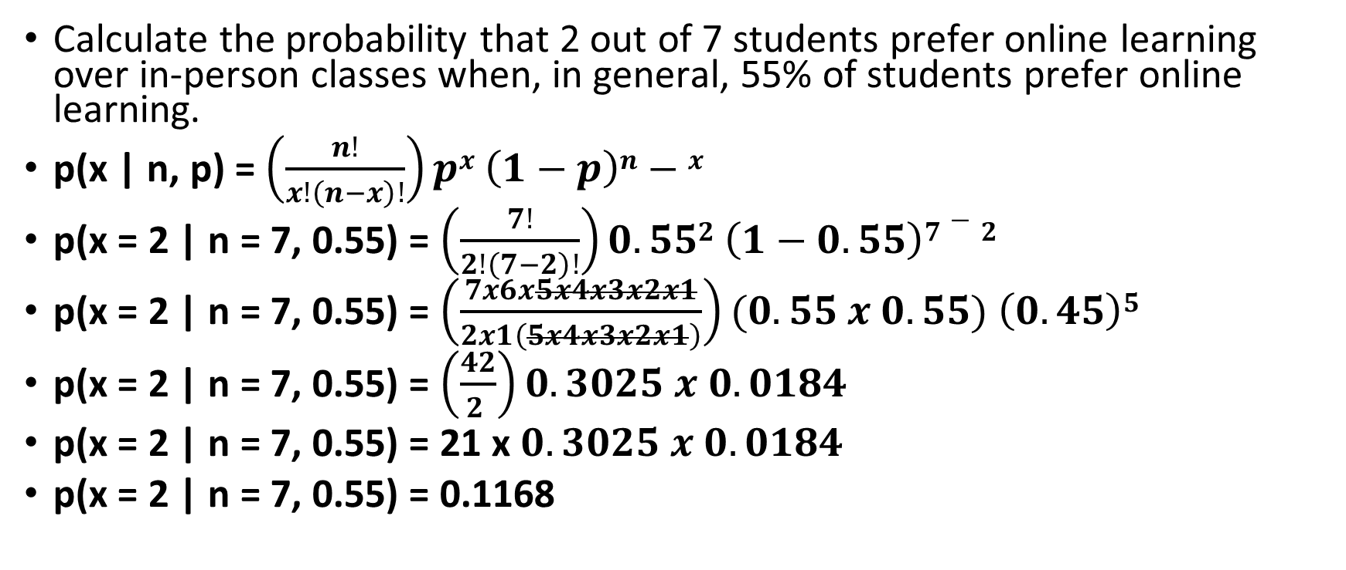
Exercise (Solve + Code)
Calculate the probability that 2 out of 7 students prefer online learning over in-person classes when, in general, 55% of students prefer online learning.
p(x | n, p) = $\left(\frac{n!}{x!\left(n−x\right)!}\right)px \left(1−p\right)n−x$
p(x = 2 | n = 7, 0.55) = $\left(\frac{7!}{2!\left(7−2\right)!}\right)0.552 \left(1−0.55\right)7−2$
p(x = 2 | n = 7, 0.55) = $\left(\frac{7x6x5x4x3x2x1}{2x1\left(5x4x3x2x1\right)}\right)(0.55 x 0.55) \left(0.45\right)5$
p(x = 2 | n = 7, 0.55) = $\left(\frac{42}{2 }\right)0.3025 x 0.0184$
p(x = 2 | n = 7, 0.55) = 21 x $0.3025 x 0.0184$
p(x = 2 | n = 7, 0.55) = 0.1168

Slide 15
Understanding PMF and CDF
Probability Mass Function (PMF): Probability at a specific point
Cumulative Distributed Function (CDF): Cumulative probability up to a specific point
Example: Consider tips dataset
Suppose we define success as tip >= 15% of the total bill amount
PMF = Probability for each possible number of successful tips, e.g.
P(X=0) -> Probability that none of the tips are at least 15%
P(X=1) -> Probability that exactly one tip is at least 15%
P(X=2) -> Probability that exactly two tips are at least 15%
… up to the total number of tips
CDF = Cumulative probability at that point
C:\code\Data Analytics\binomial_distribution_tips_understanding.py

